Slide 1
Object Oriented Programming /C++ A.S.M Delwar Hossain Lecturer Dept. Of CSE,VU

Slide 2
Course Title: Object Oriented Programming Course Code: CSE 133

Slide 3
Relation of C and C++
C++ is the super class of C
Supports object oriented programming concept
C++
C

Slide 4
What is C++
C++ is an object oriented programming language.
C++ is an extension of C with a major addition of the class construct feature.
Features like classes, inheritance, function overloading, and operator overloading make C++ a truly object-oriented language.
OO features in C++ allow programmers to build large programs with simplicity, extensibility and ease of maintenance

Slide 5

Simple Program using C++
#include<iostream>
using namespace std;
main()
{
int width, length, height;
int volume;
cout << "Please enter Width"<< endl;
cin >>width;
cout << "Please enter Length"<< endl;
cin >>length;
cout << "Please enter Height"<< endl;
cin >>height;
volume = width*length*height;
cout << "A floor of "<<width<<" x "<<length<<" x "<<height<<
" metres equals "<<volume<<" m3"<< endl;
}

Slide 6
C++ Tokens and Data Types
Keywords
Identifiers
Constants
Strings
Operators
C++ Data Types
User-defined type
structure
union
class
enumeration
Built-in type
Integral type
Derived type
array
function
pointer
reference
Void
Floating type
float
double
int
char
Tokens
Data Types

Slide 7
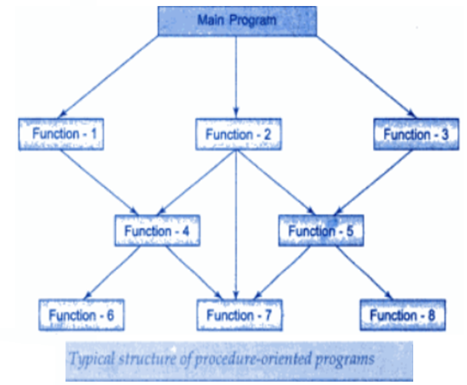
Procedure Oriented Programming
Emphasis in on doing things (algorithms)
Large programs are divided into smaller programs known as function.
Most of the functions share global data.
Data move openly around the system from function to function.
Employs top-down approach in program design.

Slide 8
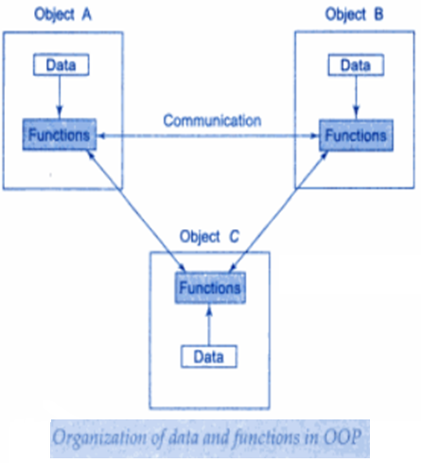
OOP
Emphasis is on data rather than procedure
Programs are divided into what are known as objects.
Data structures are designed such that they characterize the objects.
Function that operate on the data of an object are tied together in the data structure.
Data is hidden and cannot be accessed by external functions.
Objects may communicate with each other through functions.
New data and functions can be easily added whenever necessary.
Follows bottom-up approach in program design.

Slide 9
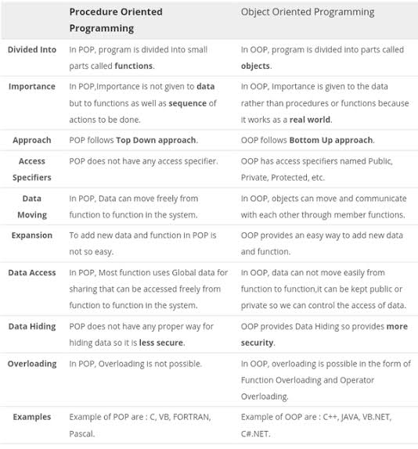
POP vs OOP

Slide 10
OOP
Object oriented programming encourages programmers to decompose a problem into its constituent parts.
Abstraction
Dynamic Binding
Message Passing
Inheritance
OOP
Encapsulation
Class and Object
Polymorphism

Slide 11
OOP: Encapsulation
Definition
Encapsulation is the mechanism that binds together code and the data it manipulates, and keeps both safe from outside interference and misuse.
Encapsulation is the technique of making the fields in a class private and providing access to the fields via public methods.
In object oriented language, code and data can be combined in such way that a self-contained “black box” is created.
Private
Public

Slide 12
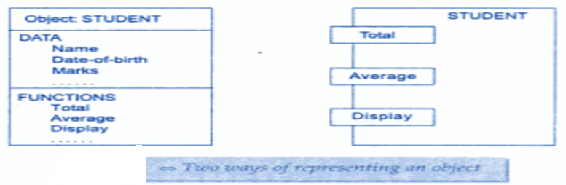
OOP: Object
Definition
Objects are basic run time entities in an object oriented system. They may represent a person, a place, a bank account, a table of data or any item that the program has to handle.

Slide 13
OOP: Class
Definition
The entire set of data and code of an object can be made a user-defined data type with the help of a class.
In fact, objects are variables of the type class.
Fruit mango;

Slide 14
OOP: Inheritance
Definition
Inheritance is the process by which one object can acquire the properties of another.
Hierarchical classification

Slide 15
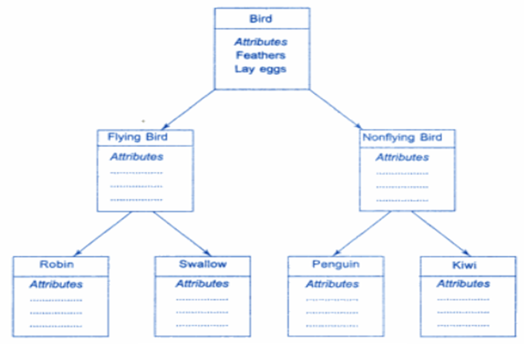
OOP: Inheritance

Slide 16
OOP: Polymorphism
Definition
Polymorphism is the quality that allows one name to be used for two or more related but technically different purposes.
One interface, multiple methods
Function overloading
Operator overloading

Slide 17
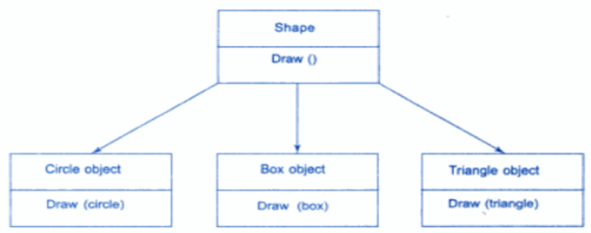
OOP: Polymorphism
Definition
Polymorphism is the quality that allows one name to be used for two or more related but technically different purposes.

Slide 18
OOP: Data abstraction
Definition
Data abstraction refers to providing only essential information to the outside world and hiding their background details, i.e., to represent the needed information in program without presenting the details.
Public function to access private member

Slide 19
OOP: Data abstraction
Abstraction is a process of hiding the implementation details and showing only functionality to the user.
Another way, it shows only important things to the user and hides the internal details for example sending sms, you just type the text and send the message. You don't know the internal processing about the message delivery.
Let's take one real life example of a TV which we can
turn on and off,
change the channel,
adjust the volume, and
add external components such as
speakers,
VCRs, and
DVD players etc.
But we do not know it's internal detail that is,
how it receives signals over the air or through a cable,
how it translates them, and finally
displays them on the screen.

Slide 20
OOP: Dynamic Binding
Definition
Binding refers to the linking of a procedure call to the code to be executed in response to the call.
When type of the object is determined at run-time, it is known as dynamic binding.
In this process, an overridden method is called through the reference variable of a superclass. The determination of the method to be called is based on the object being referred to by the reference variable.

Slide 21
OOP: Message passing
Definition
An object-oriented programming consists of a set of objects that communicate with each other. The process of programming in an object-oriented language, therefore, involves the following basic steps:
Creating classes that define objects and their behavior.
Creating objects from class definitions and
Establishing communication among objects

